Slide 1
Comment structure visualization exploration
Group 04
Group:包佳诚 范奕成 梁栋
Notes:
评论的可视化探索

Slide 2

Aim
Discover Unique Games: A Deep Dive into Steam Reviews
Notes:
通过游戏评论分析，发现游戏独特之处

Slide 3
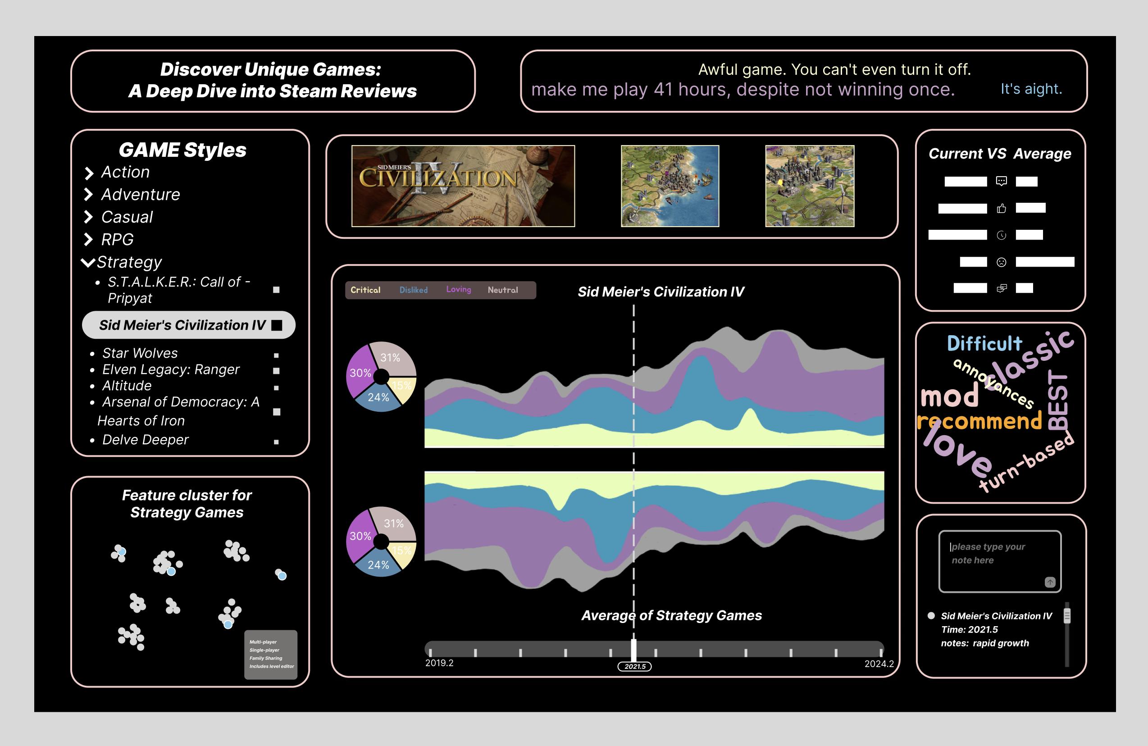

Slide 4
Agenda
Agenda
01
02
03
Data processing
Interaction
Findings

Slide 5
Data processing

Slide 6
Game Selection
· significant variance in the popularity of each game
· top 10 games in terms of comment counts for each category
· individual games VS.
average performance of top 10 games
Notes:
由于给到的数据中游戏非常的杂，每个游戏的热度有很大的区别，这就导致了这些游戏的评论数量分布非常的畸形，那么为了方便我们的数据处理以及绘图的视觉效果，我们选取了每个类别中评论数量top10的游戏来进行分析。然后我们大多数情况下也是通过单个游戏和这些top10游戏的平均情况进行对比来分析的。

Slide 7
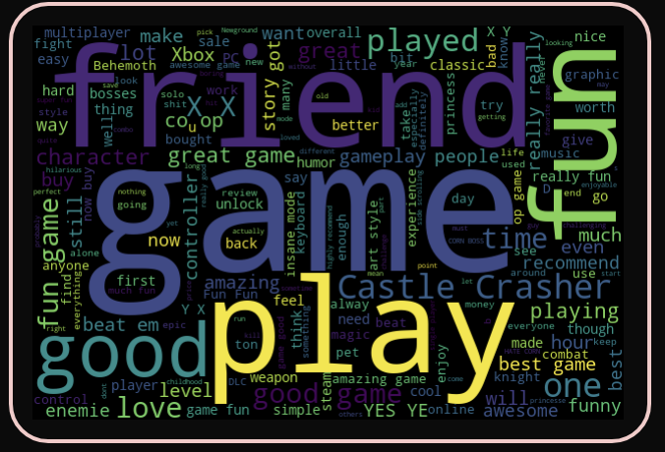
Wordcloud generation
python libraries: jieba and wordcloud
Notes:
然后是我们的词云图生成部分，我们主要使用了两个Python库，一个是jieba，用来帮助我们进行分词，然后就是wordcloud库，来生成词云图。

Slide 8
Sentiment analysis
VADER: a rule-based sentiment analysis tool
· Negative word processing: identify negative words (such as "not", "never")
· Emphasis word processing: Identify emphasis words (such as "very", "extremely")
· CAPS SENSITIVITY
· Repetition processing !!!!!
· Combining Rules
Output sentiment scores:
praise: > 0.8 !
positive: > 0.5
negative: < - 0.5
neutral: - 0.5 ~ 0.5
Notes:
下面是我们的重点，也就是sentiment的分类问题。在这一部分，我们使用了一个模型，叫做VADER。这个模型根据很多条规则来对我们的review进行情绪上的一个评分，叫做compound分数。下面我来介绍一下他的一些规则。第一个是他会重视评论中的否定词，如果出现否定词，那么整个review的情感倾向会发生改变，然后就是强调词，在强调词后面的词语会被额外重视，那么这个词的词性会对整个review的情绪分类产生更大的影响。同时，他也会额外注意到大写的词语，以及重复出现的符号。通过这些规则给出的compound评分决定了review的情绪分类。评分大于0.8，他就被看成是非常喜欢这个游戏，那么我们给到他一个praise的标签。然后按照分数的高低还会被分成positive，negative还有中立三种情绪。这样就能给我们的河流图一个更加细致的情绪分类数据。

Slide 9
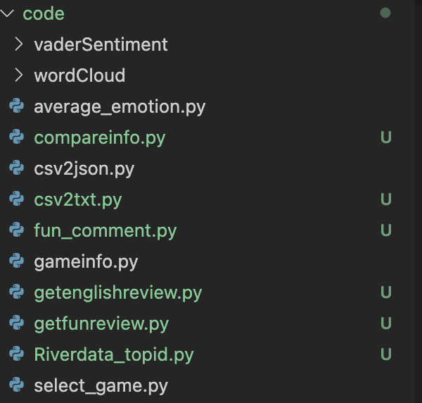
Our Work
Notes:
我们还做了很多其他的data processing的工作，这里列出了我们处理数据的Python文件。

Slide 10
Interaction

Slide 11
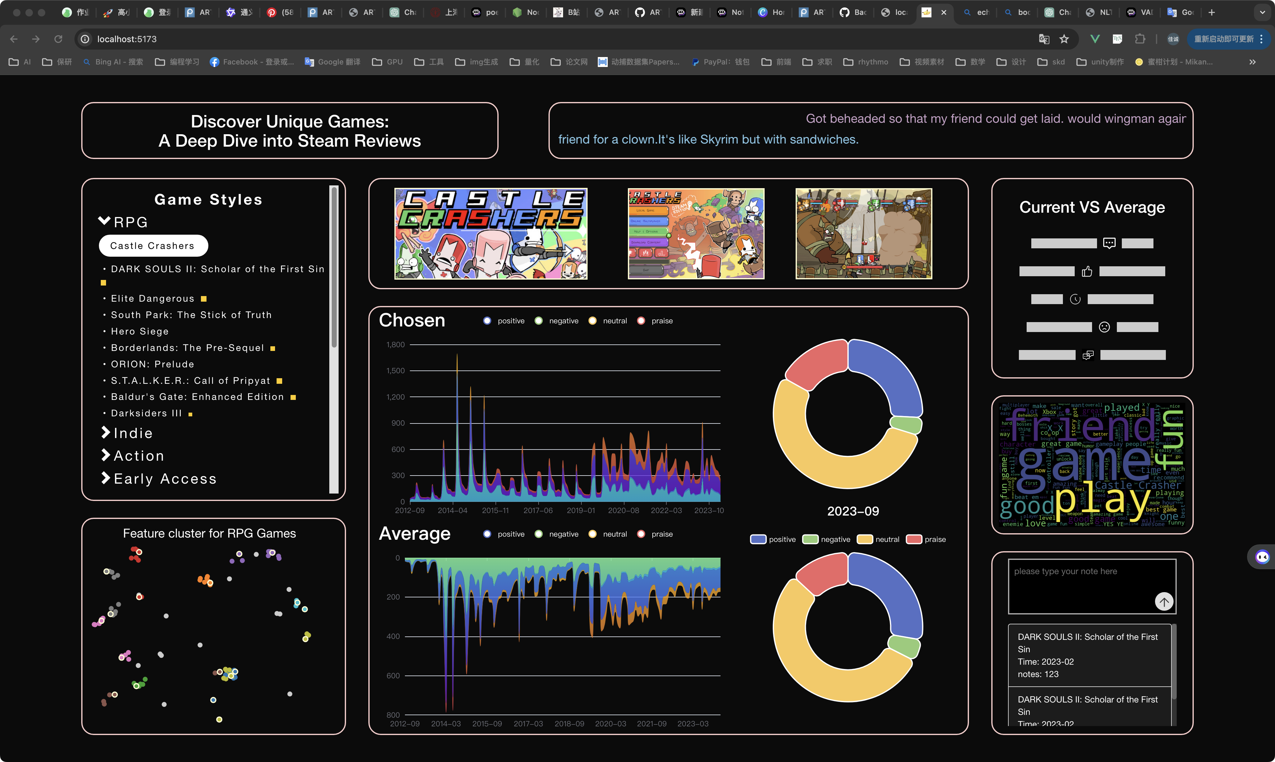
Interaction
Feature clustering
Cluster feature of the same category
Mouseover label
02
Game seclection
01
Figure display
Unfold game style
Select specific game
Send game id to other vue files
Funny comments
Bar chart comparison
03
Sample funny comments
Compare in multiple dimension
Save info
05
Get game name&timestamp
Type notes
Save&show the info
04
RiverGraph&Pie-chart
Sectect time to draw piechart
Send time to save section

Slide 12
Interaction
Feature clustering
Cluster feature of the same category
Mouseover label
02
Game seclection
01
Figure display
Unfold game style
Select specific game
Send game id to other vue files
Funny comments
Bar chart comparison
03
Sample funny comments
Compare in multiple dimension
Save info
05
Get game name&timestamp
Type notes
Save&show the info
04
RiverGraph&Pie-chart
Sectect time to draw piechart
Send time to save section

Slide 13
Interaction
Feature clustering
Cluster feature of the same category
Mouseover label
02
Game seclection
01
Figure display
Unfold game style
Select specific game
Send game id to other vue files
Funny comments
Bar chart comparison
03
Sample funny comments
Compare in multiple dimension
Save info
05
Get game name&timestamp
Type notes
Save&show the info
04
RiverGraph&Pie-chart
Sectect time to draw piechart
Send time to save section

Slide 14
Interaction
Feature clustering
Cluster feature of the same category
Mouseover label
02
Game seclection
01
Figure display
Unfold game style
Select specific game
Send game id to other vue files
Funny comments
Bar chart comparison
03
Sample funny comments
Compare in multiple dimension
Save info
05
Get game name&timestamp
Type notes
Save&show the info
04
RiverGraph&Pie-chart
Sectect time to draw piechart
Send time to save section

Slide 15
Interaction
Feature clustering
Cluster feature of the same category
Mouseover label
02
Game seclection
01
Figure display
Unfold game style
Select specific game
Send game id to other vue files
Funny comments
Bar chart comparison
03
Sample funny comments
Compare in multiple dimension
Save info
05
Get game name&timestamp
Type notes
Save&show the info
04
RiverGraph&Pie-chart
Sectect time to draw piechart
Send time to save section

Slide 16
Interaction
Feature clustering
Cluster feature of the same category
Mouseover label
02
Game seclection
01
Figure display
Unfold game style
Select specific game
Send game id to other vue files
Funny comments
Bar chart comparison
03
Sample funny comments
Compare in multiple dimension
Save info
05
Get game name&timestamp
Type notes
Save&show the info
04
RiverGraph&Pie-chart
Sectect time to draw piechart
Send time to save section

Slide 17
Interaction
Feature clustering
Cluster feature of the same category
Mouseover label
02
Game seclection
01
Figure display
Unfold game style
Select specific game
Send game id to other vue files
Funny comments
Bar chart comparison
03
Sample funny comments
Compare in multiple dimension
Save info
05
Get game name&timestamp
Type notes
Save&show the info
04
RiverGraph&Pie-chart
Sectect time to draw piechart
Send time to save section

Slide 18
Interaction
Feature clustering
Cluster feature of the same category
Mouseover label
02
Game seclection
01
Figure display
Unfold game style
Select specific game
Send game id to other vue files
Funny comments
Bar chart comparison
03
Sample funny comments
Compare in multiple dimension
Save info
05
Get game name&timestamp
Type notes
Save&show the info
04
RiverGraph&Pie-chart
Sectect time to draw piechart
Send time to save section

Slide 19
Interaction
Feature clustering
Cluster feature of the same category
Mouseover label
02
Game seclection
01
Figure display
Unfold game style
Select specific game
Send game id to other vue files
Funny comments
Bar chart comparison
03
Sample funny comments
Compare in multiple dimension
Save info
05
Get game name&timestamp
Type notes
Save&show the info
04
RiverGraph&Pie-chart
Sectect time to draw piechart
Send time to save section

Slide 20
Findings

Slide 21
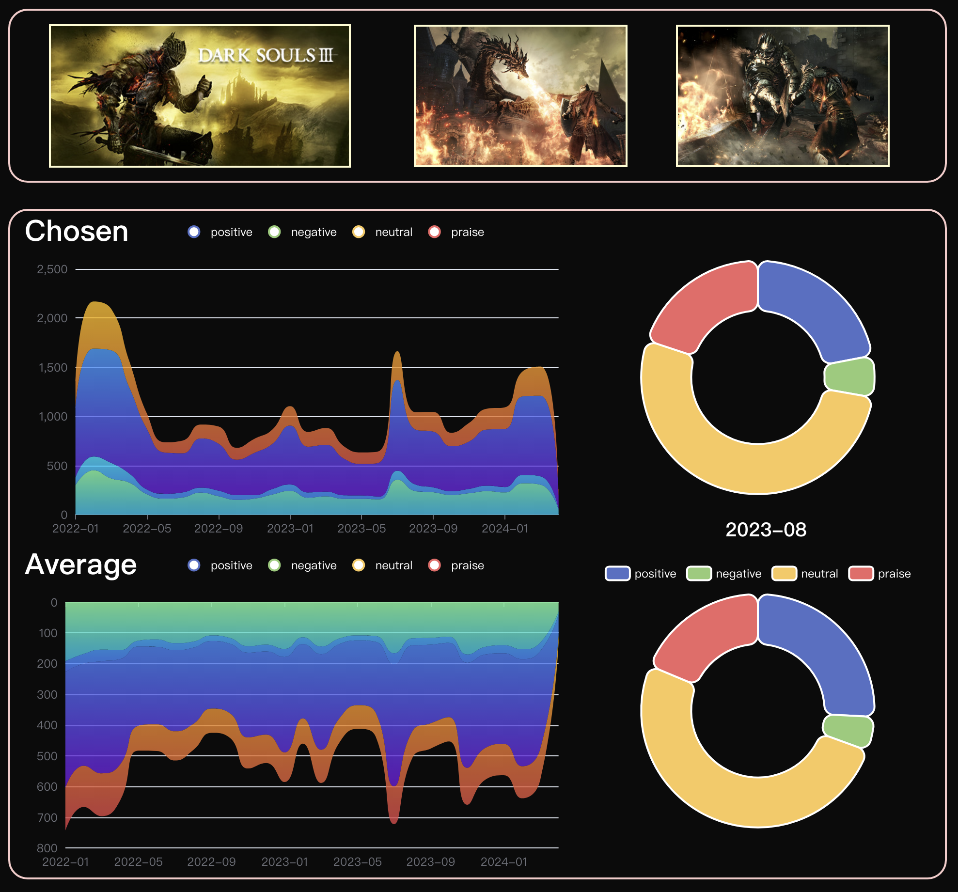
DarkSoul III
Notes:
我们翻看darksoul3的河流图的时候，发现他的评论数量在游戏刚发布的时候远远超过了同时期top10的平均数据，然后我们就对这一点分析了原因，发现darksoul2同样作为动作类别的热门游戏，他的评论数量和点赞数都普遍高于平均值，那么他就为这个游戏系列打下了用户基础，这就让黑魂3在刚发布的时候评论数量暴涨，甚至超过了2000，但是同时期的平均数据只有七八百。

Slide 22
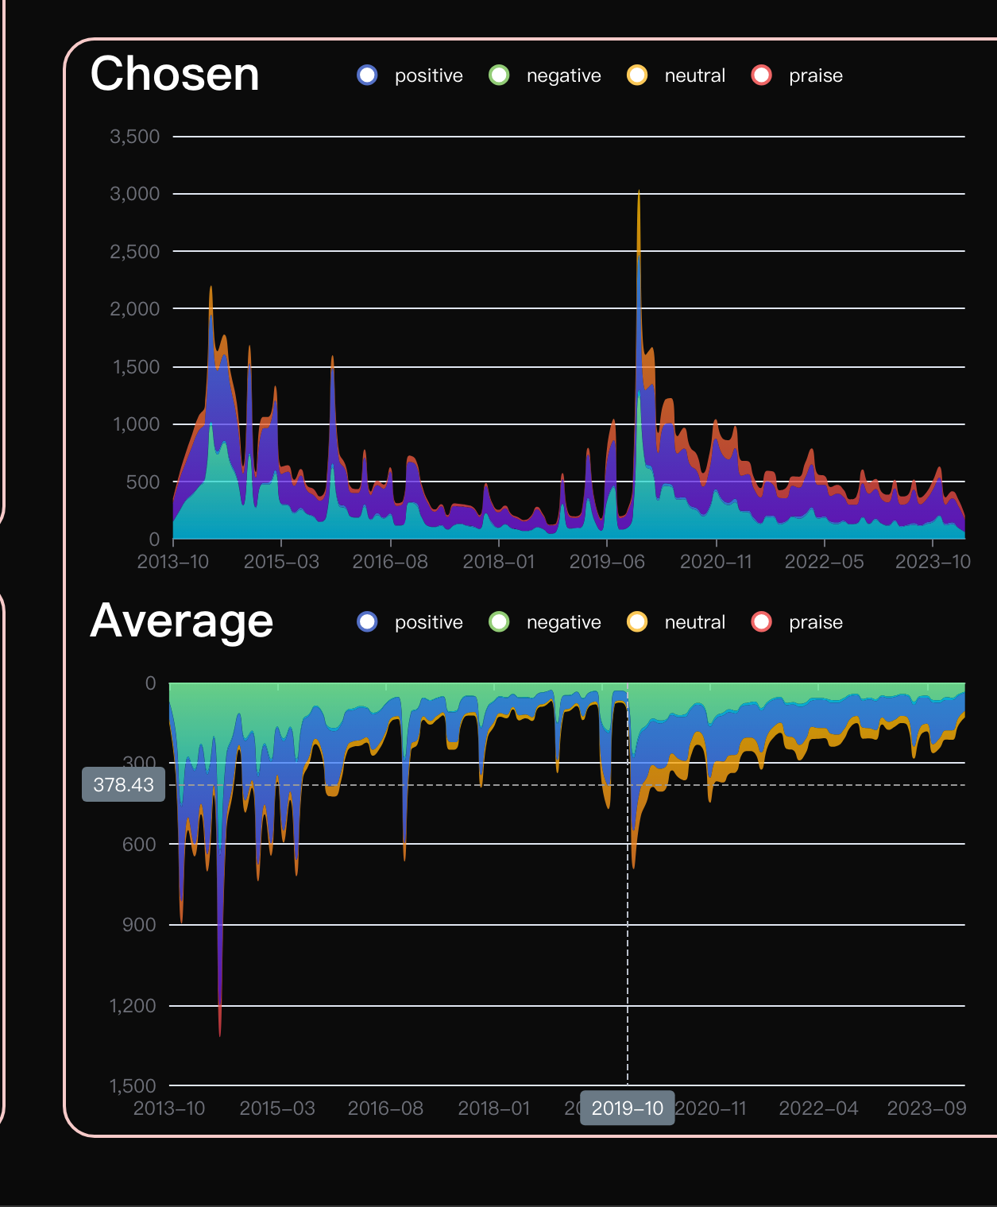
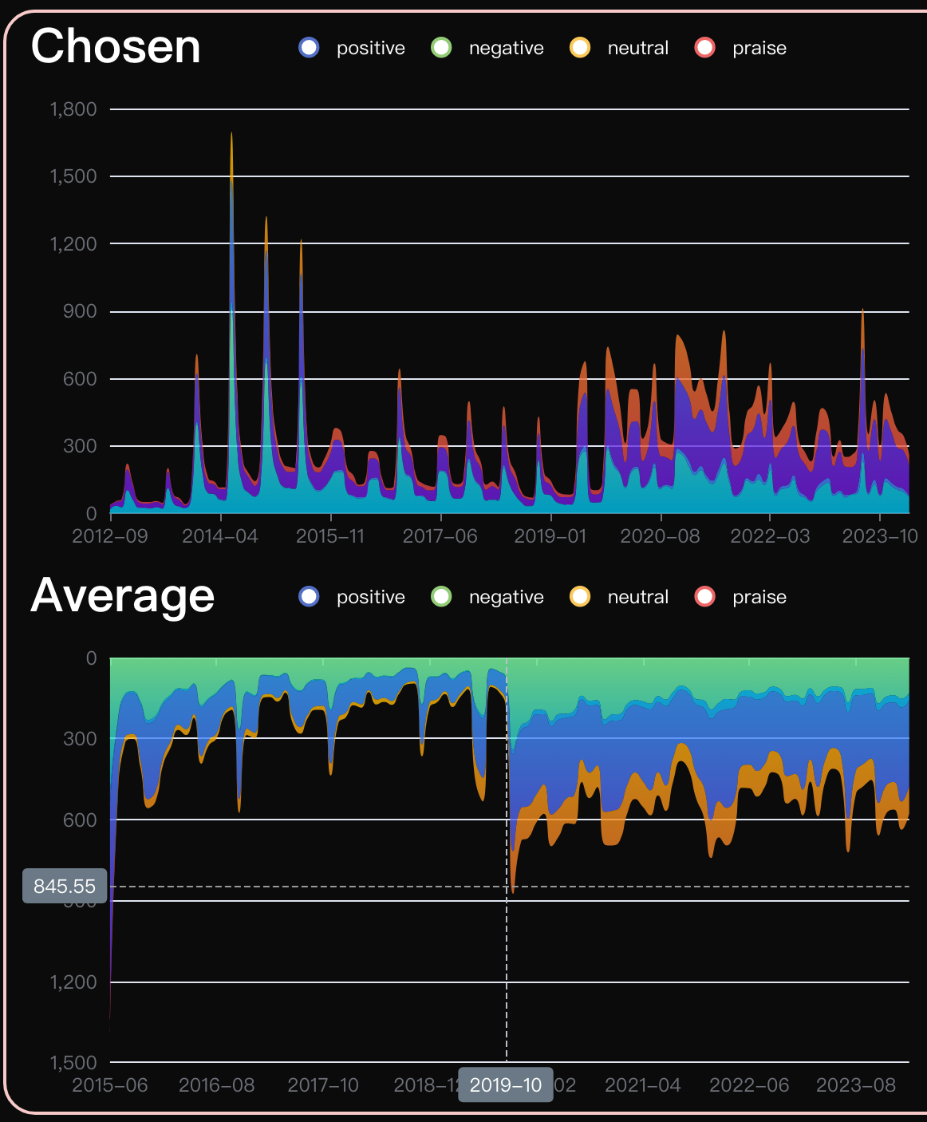
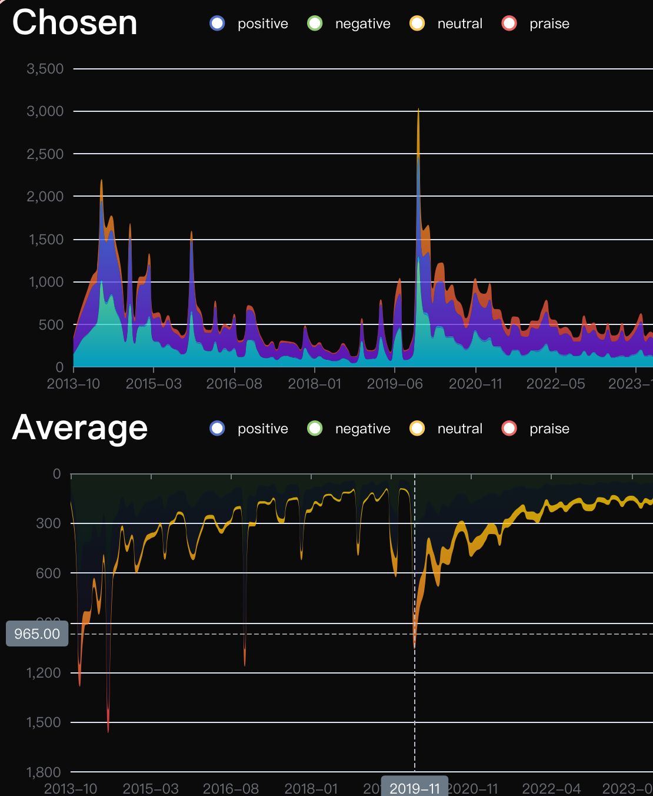
2020
Indie
Action
Strategy
Notes:
独立制作&动作游戏&策略游戏。 2019.11月的几个月秋季大促，衔接疫情，所以游戏热度都比较高）

Slide 23
User study
User1: 虽然我平时不玩端游，但在看到这款游戏的图片和相关的积极情绪分类后，我对它产生了浓厚的兴趣。
User2: (资深steam玩家)游戏总体评价符合我对这些游戏的预期。
User3:我自己就是个文明六玩家，宣战根本不慌的那种。我看到你们这个系统里文明六的分数很高啊，而且好评数也很多，甚至praise都能占到四分之一，几乎都没有差评，这很符合我对文明六的刻板印象。
User4: 记录功能很棒，能帮我挑选出游戏，就是游戏数量太少了。
User5:我喜欢玩生存建造类游戏，我在系统中探索了饥荒这个游戏，funny comment中的“新手的时候什么都不懂，晚上直接被影怪抡死了”真是太真实了！我看到他各个维度都比平均的数据高，果然是一个好游戏！

Slide 24
Labor
包佳诚：
框架，类别图，散点图，图片呈现，记录区域
范奕成：
情绪分类，词云图，河流图，饼图
梁栋：
趣味评论展示，比较柱状图，部分数据整理

Slide 25
Thank you
包佳诚 范奕成 梁栋

